Slide 1
CSd0603: minor project
Submitted By:-
PrabhanshuSisodia(betn1cs20030)
Bhawesh agrawal(BETN1CS20101)
Akul gupta (betn1cs20003)
Submitted TO:-
Dr. Vani Agrawal,
Associate Professor
CSA, SOET, ITM University

Slide 2
Online Grocery management with collaborative filtering recommendation system

Slide 3
TABLE OF CONTENTS
01
02
03
ABOUT THE PROJECT
MAJOR REQUIREMENTS
Flask

Slide 4
TABLE OF CONTENTS
04
05
06
Collaborative filtering
PROJECT screenshots
OUR TEAM

Slide 5

About project
In this project we are creating an E-Commerce website using Flask web framework.
When a user is browsing through the products on the website, the website will recommend similar products to the user , which he/she is more likely to buy.
This recommender system will be based on item-to-item similarity collaborative filtering.

Slide 6
Major Requirements
Required libraries:-
Flask
Numpy
Pandas
Sklearn
Json
Pickle
A desktop/laptop
Python 3 or above in system
Internet Connection
Atleast than 8GB of RAM
i3 core processor or above

Slide 7
Flask
Flask is a web framework, it’s a Python module that lets you develop
web applications easily. It’s has a small and easy-to-extend core: it’s a microframework that doesn’t include an ORM (Object Relational Manager) or such features.
It does have many cool features like url routing, template engine. It is a WSGI web app framework.
Flask is very Pythonic. It’s easy to get started with Flask, because it doesn’t have a huge learning curve.
On top of that it’s very explicit, which increases readability.

Slide 8
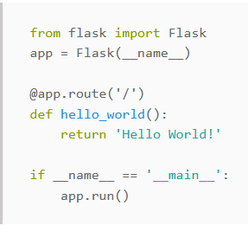
Flask boilerplate example

Slide 9
JINJA2
Jinja is a fast, expressive, extensible templating engine. Special placeholders in the template allow writing code similar to Python syntax. Then the template is passed data to render the final document.
It includes:
Template inheritance and inclusion.
Define and import macros within templates.
HTML templates can use autoescaping to prevent XSS from untrusted user input.

Slide 10
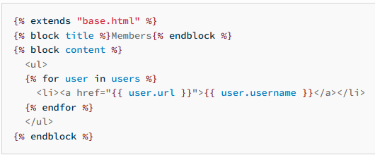
Jinja Template example

Slide 11
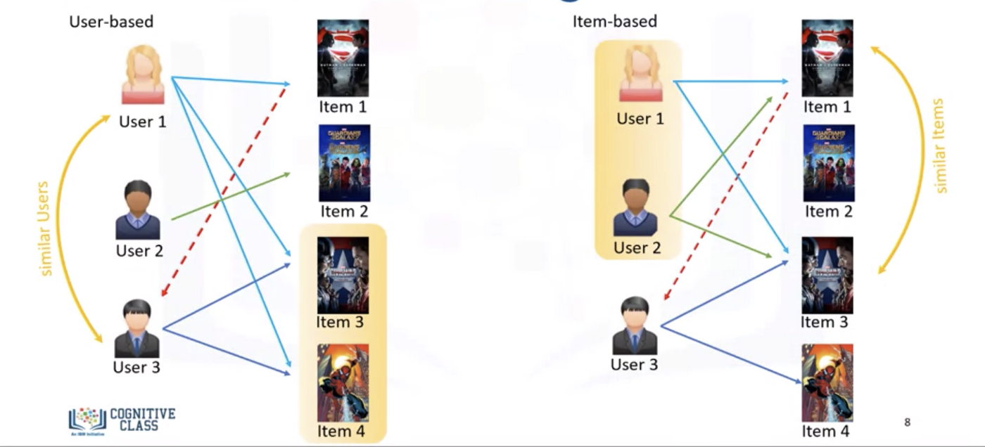
Collaborative Filtering

Slide 12
Collaborative Filtering Recommender System
In Collaborative Filtering, we tend to find similar users and recommend what similar users like. In this type of recommendation system, we don’t use the features of the item to recommend it, rather we classify the users into the clusters of similar types, and recommend each user according to the preference of its cluster.
Measuring Similarity:
Cosine Distance: We can use the cosine distance between the users to find out the users with similar interests, larger cosine implies that there is a smaller angle between two users, hence they have similar interests. We can apply the cosine distance between two users in the utility matrix.
We have used sklearn.metrics.pairwise.cosine_similarity in this project.

Slide 13
Item-to-Item Based Collaborative Filtering
Rather than matching the user to similar customers, item-to-item collaborative filtering matches each of the user’s purchased and rated items to similar items, then combines those similar items into a recommendation list. To determine the most-similar match for a given item, the algorithm builds a similar-items table by finding items that customers tend to purchase together. We could build a product-to-product matrix by iterating through all item pairs and computing a similarity metric for each pair. However, many product pairs have no common customers, and thus the approach is inefficient in terms of processing time and memory usage.

Slide 14
The key to item-to-item collaborative filtering’s scalability and performance is that it creates the expensive similar-items table offline.
The algorithm’s online component — looking up similar items for the user’s purchases and ratings — scales independently of the catalog size or the total number of customers; it is dependent only on how many titles the user has purchased or rated.
Thus, the algorithm is fast even for extremely large data sets. Because the algorithm recommends highly correlated similar items, recommendation quality is excellent.
Unlike traditional collaborative filtering, the algorithm also performs well with limited user data, producing high-quality recommendations based on as few as two or three items.

Slide 15
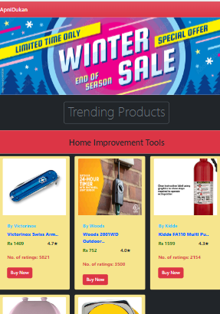
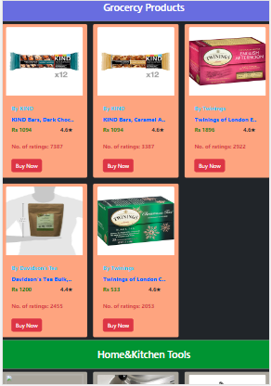
Project snapshots

Slide 16

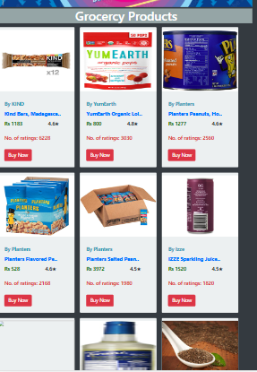

Slide 17
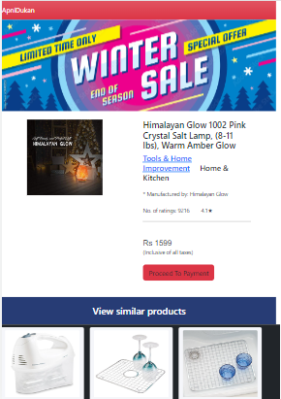


Slide 18
THANK You

